Slide 1

Working with Assistants Part 12: Working with File Search

Slide 2
What’s Covered in This Session
Understanding File Search
Creating an Assistant with File Search Capability
Understanding Vector Stores
Creating Vector Stores
Joining Vector Stores to Assistants
Creating a Vector Store with a Thread
Getting the Results
Listing Vector Stores
Retrieving Vector Stores
Modifying Vector Stores
Deleting Vector Stores

Slide 3
Understanding File Search
Digging Through Your Text
Notes:
https://platform.openai.com/docs/assistants/tools/file-search/quickstart

Slide 4
Assistant Tools
File Search
Code Interpreter
Function
Notes:
https://platform.openai.com/docs/api-reference/assistants/createAssistant#assistants-createassistant-tools

Slide 5
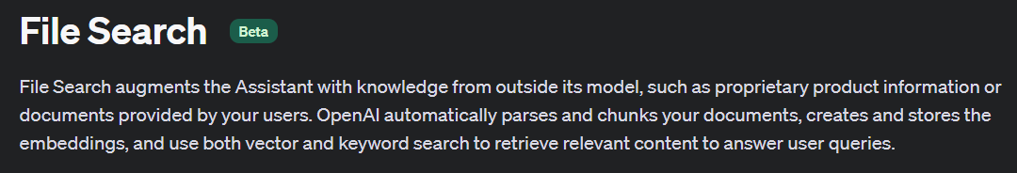

Slide 6
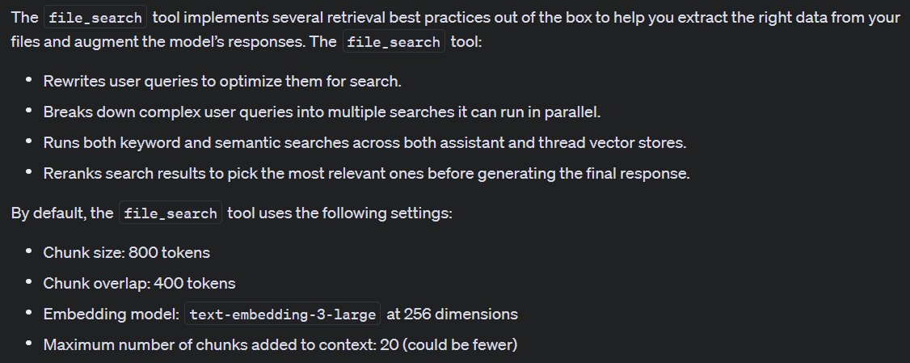

Slide 7
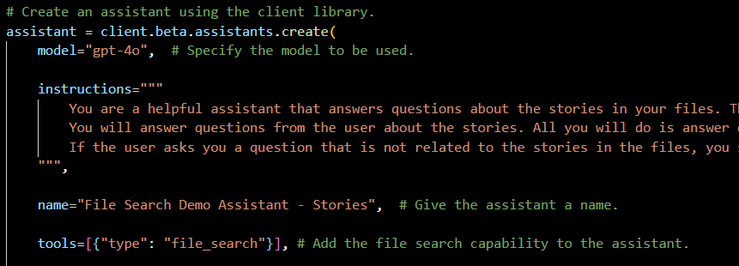
Demo: Creating an Assistant with File Search Capability

Slide 8



Notes:
https://www.youtube.com/channel/UC35ZpwldGw7ZJ5R-2sLijzw

Slide 9


Membership has its privileges
Notes:
https://www.youtube.com/channel/UC35ZpwldGw7ZJ5R-2sLijzw/join

Slide 10
Understanding Vector Stores
Storing Your Data for Searches
Notes:
https://platform.openai.com/docs/api-reference/vector-stores

Slide 11
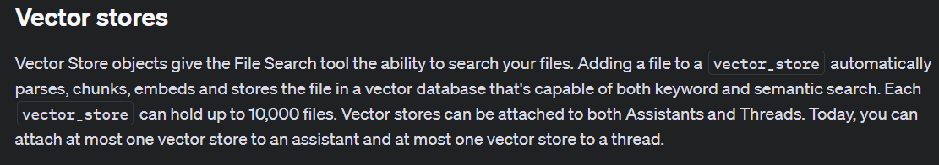
Notes:
https://platform.openai.com/docs/api-reference/vector-stores

Slide 12

Vector Store Possible Locations
THREAD
ASSISTANT
RUN
MESSAGE
Notes:
https://platform.openai.com/docs/api-reference/vector-stores

Slide 13
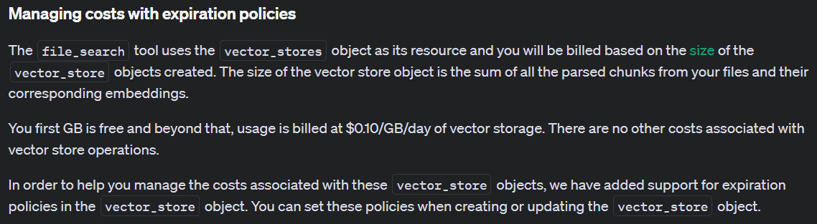
Notes:
https://platform.openai.com/docs/assistants/tools/file-search/managing-costs-with-expiration-policies

Slide 14
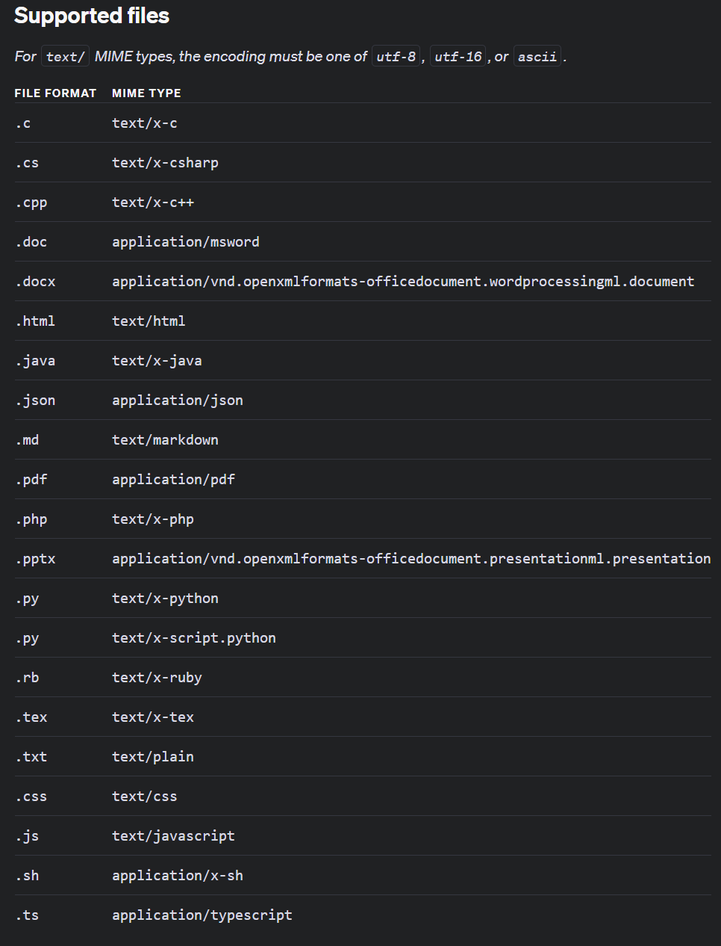
Notes:
https://platform.openai.com/docs/assistants/tools/file-search/supported-files

Slide 15
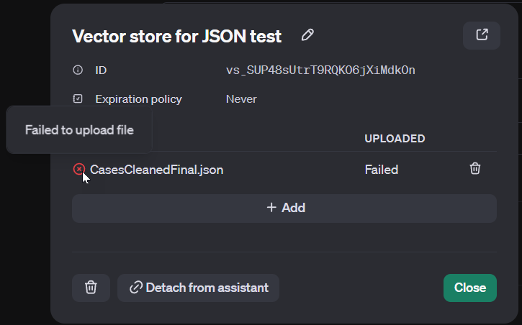
JSON Warning!

Slide 16
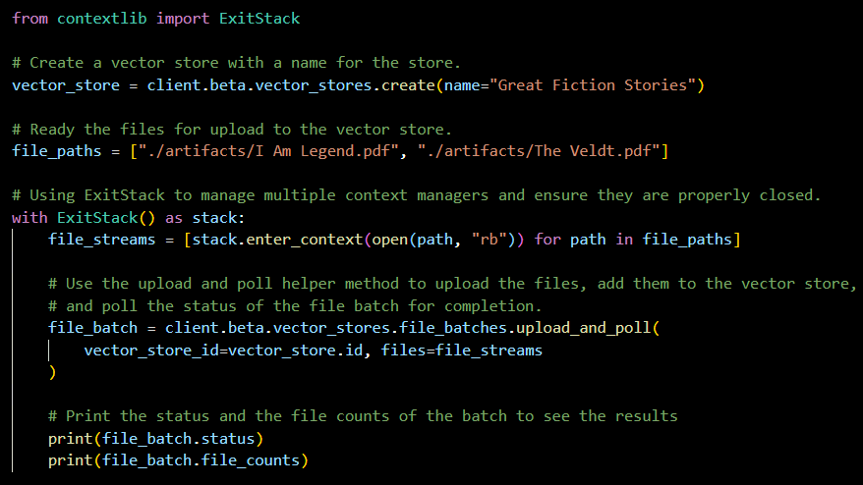
Demo: Creating a Vector Store

Slide 17


